Slide 1
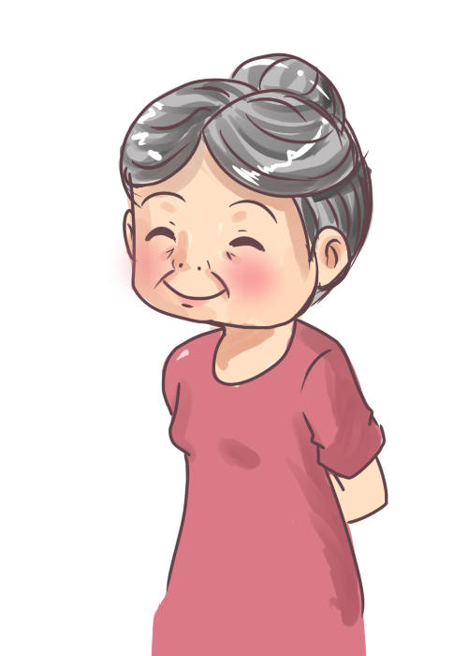
Care Pathway
GP
Social Worker
Care support services
Physiotherapist
Pharmacist
Occupational Therapist
Falls clinic
Memory clinic (Husband)

